Slide 1
Lunch and Learn:
Research 101
February 17, 2022
Amanda Brooks, PhD
Director of Research and Scholarly Activity
Associate Professor of Molecular Biology

Slide 2
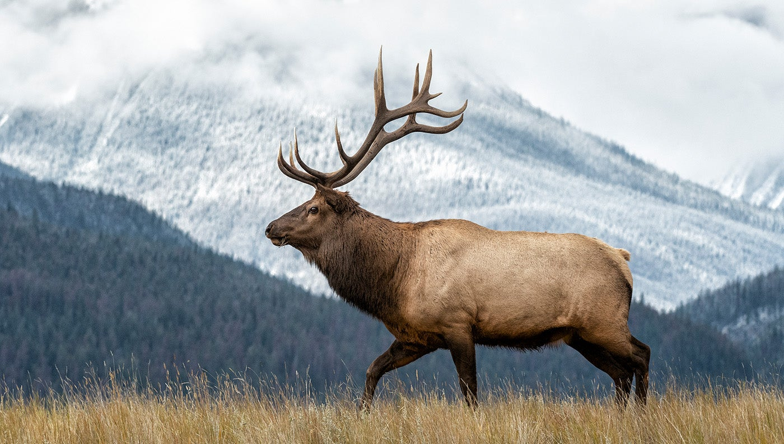
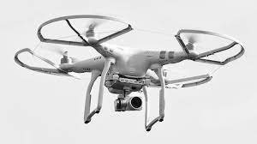
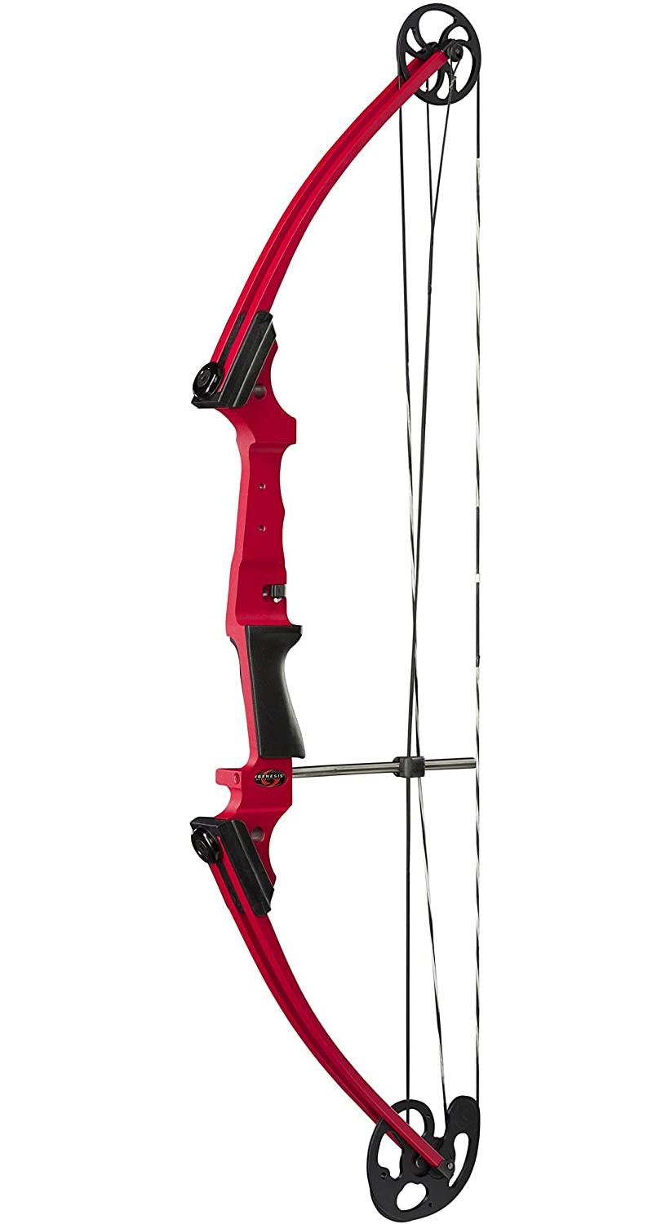
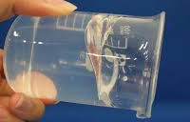
Research & Scholarly Innovation
Problem: You need to design a new system to deliver a CWD vaccine to elk. How will you do it?
Think outside the box
Don’t limit yourself by resources

Slide 3
Learning Objectives
Discuss why research and scholarly activity is important at RVU
Describe the RVU process for conducting research and scholarly activity
Identify resources for conducting research and scholarly activity
https://thepeakperformancecenter.com/business/learning/business-training/learning-objectives/
Overall Goal: Demystify research and scholarly activity
https://spencerauthor.com/taking-research-to-the-next-level-in-project-based-learning/

Slide 4
What is research?
Research is defined as a systematic investigation into a topic or material in order to establish facts and reach a conclusion.
Scholarly activity is defined as creative works that are peer reviewed and publically disseminated.

Slide 5
Mission Statement
The mission of the office of research is to advance, promote and celebrate research and scholarly activities occurring within the Rocky Vista University community. All areas of research from basic biological research to translational and population-based studies are supported. The office of research is committed to providing guidance and opportunities for faculty, staff, and students to engage in various research and scholarly activities that promote the advancement of biomedical and clinical sciences.
Five mission enhancement approaches:
COCA compliance
HLC outcomes measures
Recruitment
Residency Match Enhancement
Revenue Generation

Slide 6
Elevate RVU research
Submit extramural grants and contracts
Develop a research infrastructure
Develop a program of excellence in multiple areas of clinical and biomedical research
Participate in clinical trials
Promote innovation in research
Automate a clinical research match

Slide 7
Elevate RVU Research
Why?
Makes our students more competitive
Improve residency match
“Developing a stronger overall scientific reputation by contributing to major health care advances is the most critical factor in promoting osteopathic medicine.”
The Journal of the American Osteopathic Association, August 2014, Vol. 114, 608-614. doi:https://doi.org/10.7556/jaoa.2014.124

Slide 8
Quick Start Checklists
Look at the Research Resources on the RVU Office of Research website.
Feel free to join the RVU Research Opportunities and Interest Groups on Microsoft Teams, particularly if you need students.
Develop your research and scholarly interests.
Do a literature search into your topic and see what is already known.
The RVU library’s website has some good tools to teach you how to do a literature search in addition to other tools you might find helpful.
Pro Tip: I usually search at least 3 databases (mix of basic and clinical)
Pro Tip: Use a good reference manager to organize what you are finding from the very beginning. The Office of research suggests Zotero.
Write your question, hypothesis and a preliminary design.
Pro Tips:
Reach out to colleagues and have them give you feedback
Think about any downstream analyses or statistics that might be necessary and reach out for help if needed
Do an honest assessment of where your skills are not strong enough to accomplish your goals and find collaborators.
Outline any resources that will be required to meet your goals; remember to include time, people, and financial resources.
Request a Qualtrics account on iNet for survey based research and scholarly activities
Make sure that any students involved complete the Student Research Approval form on iNet
Note that you cannot be logged into iNet to sign the approval form as the mentor
Complete CITI training (Contact Laura Dement)
Obtain IRB approval if necessary (Axiom Mentor IRB)

Slide 9
RVU Research Processes
Processes (Dynamic Policy or iNet for forms):
Authorship guidance
Connecting faculty and students
Grant and contract submissions
Intellectual Property (Currently in place)
Material Transfer Agreements (MTA) (Currently in place)
Memorandums of Understanding (MOU)
Research Affiliate Agreements
Facilities Use Agreements
Resource allocation and management
Money (New grant programs) (Currently in place)
Software
Time
Student Research Authorization (Currently in place)
Tracking Publications and Presentations (Currently in place)
Others coming

Slide 10
Overall Process
Define the problem
Review the literature
Select a research design
Formulate a hypothesis
Obtain regulatory approvals
Carry out the research
Analyze the data
Report your findings

Slide 11
Find A Problem YOU Care About Ask yourself the following:
Why did you chose the career you did?
Why are you at RVU?
What problems are you/your friends/or your family facing? Can you help?
Start reading and get a good reference manager:
Pubmed/Google Scholar/Up to Date/ others
Zotero

Slide 12
Finding a topic
Brainstorm: Make a list of everything that interests you within a specific topic.
Using the first list, make a 2nd list of things you are capable of doing
Using the first list, make a 3rd list of all of the things (include resources, people, equipment, space, patient populations, etc.) that you need to accomplish your list
Prioritize your list
Don’t sell yourself short
Using the first list, make a 4th list of your ideas that are important to society, healthcare, or the profession.
Find your passion

Slide 13
Finding a topic
Compare your 4 lists:
Mark off the items on your merged list that are not feasible.
The topic that survives or is central to all other topics is the basis for your research question.
Begin a literature study of your chosen topic and set a timeline.
What items appear on each of your lists? Use these to create a single list
Remember that just because you do not pursue something at the time, does not mean that you can never do it.
Find your passion

Slide 14
Notes:
Dr. Antonia Novello was appointed Surgeon General of the United States by President George Bush in 1990, she was the first woman—and the first Hispanic—ever to hold that office.

Slide 15
Define your question/hypothesis
Make it brief
Make it clear (avoid the “and”)
Is it manageable?
What is the gap you are trying to fill?
How are you uniquely qualified to fill it?
Evaluate the Quality

Slide 16
Assess your Question and Experimental Design
https://csulb.libguides.com/nursing/pico
Notes:
Sometimes Time is included in this framework

Slide 17
Assess your Question and Experimental Design
https://guides.library.vcu.edu/rapidreview

Slide 18
The Foundation for a Program of Excellence
Resources
Equipment
Utah
Colorado
Space
Utah
Colorado
People
Student/faculty exchange across campuses for research projects
Students are our most important resources
Infrastructure
IRB submission portal – Axiom Mentor
Qualtrics
Internal grant programs
Pre and Post submission grant management

Slide 19
Find Resources
Find people to help you: Build a network
Find money
Find space
Contact me if you are having trouble with these steps: abrooks@rvu.edu

Slide 20
Mentoring – Students are our greatest resource
Who is a Mentor:
Characteristics of a good mentor
How invested should you be?
Aligning Expectations
Your mentoring philosophy/plan
Effective Communication
The Value of Diversity
Cultivating ethical behavior
Fostering Independence
https://www.nap.edu/read/5789/chapter/2#15

Slide 21
Getting started as a mentor
Who can be a mentor?
Anyone can be a mentor
May not be a formal arrangement
Top 3 adjectives you think of to describe your best mentor
Notes:
“Mentoring is collaborative. Ideally, scholars and mentors engage as partners through reciprocal activities such as planning, acting, reflecting, questioning, and problem-solving. Successful mentoring relationships are those in which scholars reach the individual milestones that allow them to progress to the next stage along the trajectory for a sustainable career. Scholar success is defined as scholars having gained 1) personal and professional competencies necessary to define their research goals, 2) relevant experience for that career, and 3) the ability and opportunity to progress toward their chosen career goal.”
“Mentorship is a professional, working alliance in which individuals work together over time to support the personal and professional growth, development, and success of the relational partners through the provision of career and psychosocial support. From the National Academies “The Science of Effective Mentorship in STEMM” released in October 2020.
“Good mentors are able to share life experiences and wisdom, as well as technical expertise. They are good listeners, good observers, and good problem-solvers. They make an effort to know, accept, and respect the goals and interests of a student.” https://www.nap.edu/read/5789/chapter/2#2

Slide 22
Characteristics of a good Mentor
Enthusiasm, passion, and positivity (inspiration and optimism)
Can these attributes be developed?
Celebrate
Sensitivity, compassion, and empathy
Listen, hear, and support
Appreciate individual differences
Remember not everyone wants to be you
Respect
Unselfishness
Availability
Balancing direction and self-direction
Give advice in the form of a suggestion or a prompting question
Take a risk: Provide opportunities for growth
Use your contacts
Don’t be afraid to be wrong or not know
Nurture creativity
Constructive criticism
Effective Mentor
Enthusiastic
Inspirational
Sensitivity
Appreciate diversity
Authentic
Advisor
Critique
Connector
Supportive
Ethical
Role model
Collaborative
This is a lot to balance, why would anyone want to be a mentor?
https://www.nature.com/articles/447791a
https://www.nap.edu/read/5789/chapter/2#2
Notes:
“Effective Mentoring has been linked to enhanced self-efficacy, persistence; research productivity, higher career satisfaction, and enhanced recruitment of underrepresented minorities into biomedical research related career pathways. At this stage in your career, you are likely both a mentor and a mentee.”

Slide 23
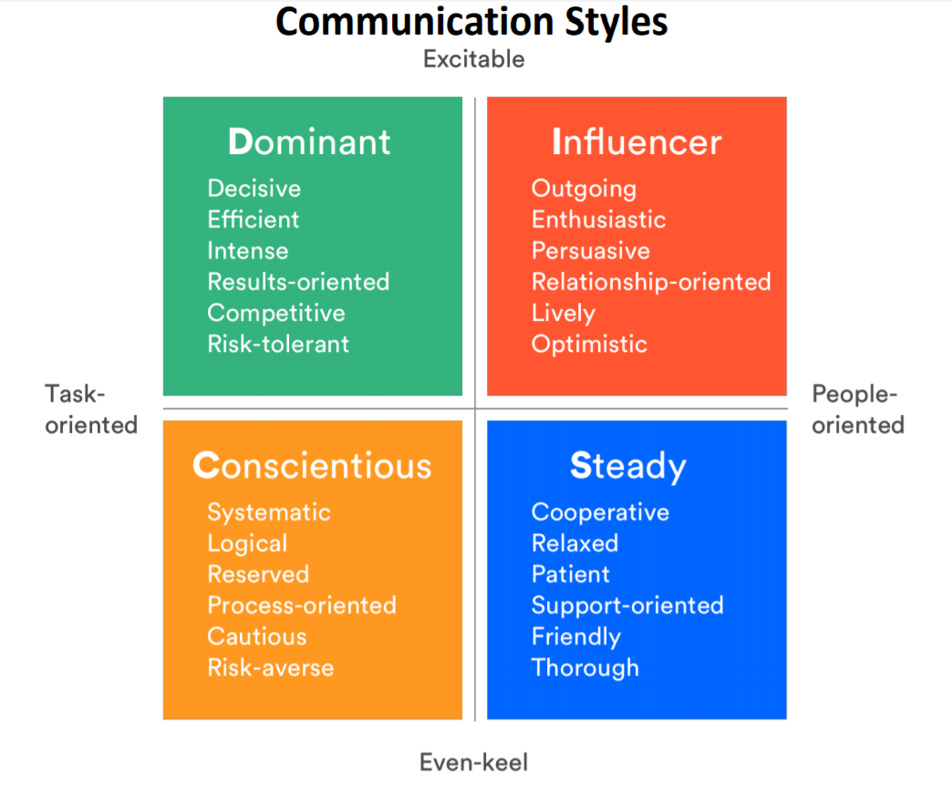
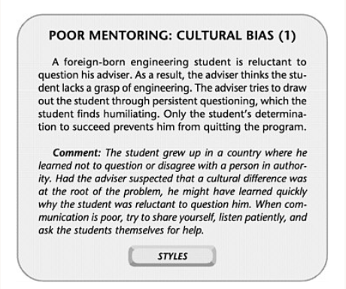
Communication is Key
Foster open communication
Use multiple strategies
Be aware of unconscious bias
“Often we hear things very differently than they were intended. These differences can be amplified across cultural backgrounds, power differentials or even communication styles. It is important to develop a “benefit of doubt’ philosophy in which you assume that the intention of the statement is good, even if it was not delivered well. This does not take the responsibility for good communication off the speaker, but rather encourages clarification before assumption. “
http://graduateschool.ufl.edu/media/graduate-school/pdf-files/Keynote-Speech-by-Dr.-Roger-Fillingim---Mentoring-Graduate-Students.pdf
Notes:
words or phrasings can be interpreted differently by gender
Men – prefer to diagnose and resolve problems
Women - talk through issues in detail and confirm their feelings
Caution: lead to stereotyping of interests, skills, or career goals

Slide 24
“Mentors can often be effective through a style that not only welcomes, nurtures, and encourages questions, but also challenges students to develop critical thinking, self-discipline, and good study habits. Expectations for minority-group students in science have traditionally been too low, and this can have an adverse effect on achievement. A clear statement that you expect the same high performance from all students might prove helpful. Be aware of minority support groups on your campus and of appropriate role models.”
https://www.nap.edu/read/5789/chapter/2#8

Slide 25
Quick Start Checklists
Look at the Research Resources on the RVU Office of Research website.
Feel free to join the RVU Research Opportunities and Interest Groups on Microsoft Teams, particularly if you need students.
Develop your research and scholarly interests.
Do a literature search into your topic and see what is already known.
The RVU library’s website has some good tools to teach you how to do a literature search in addition to other tools you might find helpful.
Pro Tip: I usually search at least 3 databases (mix of basic and clinical)
Pro Tip: Use a good reference manager to organize what you are finding from the very beginning. The Office of research suggests Zotero.
Write your question, hypothesis and a preliminary design.
Pro Tips:
Reach out to colleagues and have them give you feedback
Think about any downstream analyses or statistics that might be necessary and reach out for help if needed
Do an honest assessment of where your skills are not strong enough to accomplish your goals and find collaborators.
Outline any resources that will be required to meet your goals; remember to include time, people, and financial resources.
Request a Qualtrics account on iNet for survey based research and scholarly activities
Make sure that any students involved complete the Student Research Approval form on iNet
Note that you cannot be logged into iNet to sign the approval form as the mentor
Complete CITI training (Contact Laura Dement)
Obtain IRB approval if necessary (Axiom Mentor IRB)

Slide 26
You are well on your way… enjoy the journey

Slide 27
Coming up…
3/17 – “Good Practices for Experimental Design”
4/21 – “Good Survey Design/How to make sure your survey is valid”
5/19 – “Biases and Logical Fallacies”

