Slide 1
Intro to the Language of Anatomy
Rocky Vista University
Class of 2024

Slide 2
Intro:
The following terms will help you better engage in lectures, most professors will assume that you already know them
I made this powerpoint to mainly help those of you who have never taken Anatomy, but even if you have already taken Anatomy please refamiliarize yourself with these terms
Parts 2 and 3 are the most critical to grasp, make sure you have those down first, work on the others if you have time before the semester begins

Slide 3
Part 1: Body Systems

Slide 4
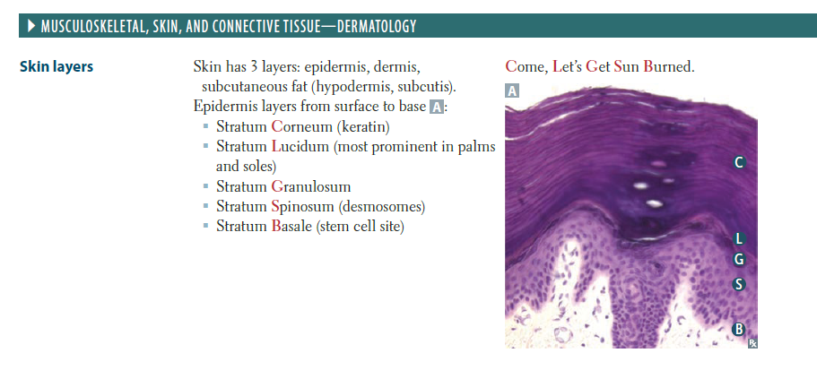
Integumentary system (dermatology)
Consists of the skin and its appendages—hair, nails, and sweat glands
Taken from FA 2019

Slide 5
Skeletal system (osteology)
Consists of bones and cartilage; provides our basic shape and support for the body and is what the muscular system acts on to produce movement. Also protects vital organs such as the heart, lungs, and pelvic organs.

Slide 6
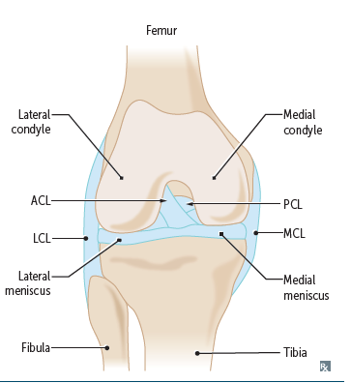
Articular system (arthrology)
Consists of joints and their associated ligaments, connecting the bony parts of the skeletal system and providing the sites at which movements occur.
Taken from FA 2019

Slide 7
Muscular system (myology)
Consists of skeletal muscles that act (contract) to move or position parts of the body, or smooth and cardiac muscle that propels, expels, or controls the flow of fluids and contained substance.

Slide 8
Nervous system (neurology)
Consists of the central nervous system (brain and spinal cord) and the peripheral nervous system (nerves and ganglia, together with their motor and sensory endings). Controls and coordinates the functions of the organ systems, enabling the body’s responses to and activities within its environment.

Slide 9
Circulatory system (angiology)
Consists of the cardiovascular and lymphatic systems, which function in parallel to transport the body’s fluids.

Slide 10
Cardiovascular system (cardiology)
Consists of the heart and blood vessels that propel and conduct blood through the body, delivering oxygen, nutrients, and hormones to cells and removing their waste products.
Taken from FA 2019

Slide 11
Lymphatic system
Network of lymphatic vessels that withdraws excess tissue fluid (lymph) from the body’s interstitial (intercellular) fluid compartment, filters it through lymph nodes, and returns it to the bloodstream.

Slide 12
Digestive (alimentary) system (gastroenterology)
Digestive tract from the mouth to anus, with all its associated organs and glands that function in ingestion, mastication (chewing), deglutination (swallowing), digestion, and absorption of food and the elimination of the solid waste (feces) remaining after the nutrients have been absorbed.

Slide 13
Respiratory system (pulmonology)
Consist of the air passages and lungs that supply oxygen to the blood for cellular respiration and eliminate carbon dioxide form it. The diaphragm and larynx control the flow of air through the system, which may also produce tone in the larynx that is further modified by the tongue, teeth, and lips into speech.

Slide 14
Urinary system (urology)
Consist of the kidneys, ureters, urinary bladder, and urethra, which filter blood and subsequently produce, transport, store, and intermittently excrete urine (liquid waste).

Slide 15
Genital (reproductive) system
Consists of the gonads (ovaries and testes) that produce oocytes (eggs) and sperms, the ducts that transport them, and the genitalia that enable their union. After conception the female reproductive tract nourishes and delivers the fetus.

Slide 16
Endocrine system (endocrinology)
Consists of specialized structures that secrete hormones, including discrete ductless endocrine glands (such as the thyroid gland) isolated and clustered cells of the gut and blood vessel walls, and specialized nerve endings.
Side note:
Hormones = organic molecules that are carried by the circulatory system to distant effector cells in all parts of the body. The influence of the endocrine system is thus as broadly distributed as that of the nervous system. Hormones influence metabolism and other processes, such as the menstrual cycle, pregnancy, and parturition (childbirth).

Slide 17
Memory Check: Joints and their associated ligaments are a part of which body system?
A: Articular
B: Skeletal
C: Integumentary
D: Nervous
E: Endocrine

Slide 18
Memory Check: Joints and their associated ligaments are a part of which body system?
A: Articular
B: Skeletal
C: Integumentary
D: Nervous
E: Endocrine

Slide 19
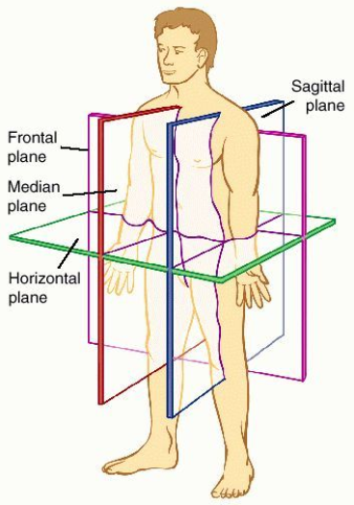
Part 2: Anatomical position, planes, and relationship
Dorland's Medical Dictionary for Health Consumers. (2007). Retrieved May 24 2019

Slide 20
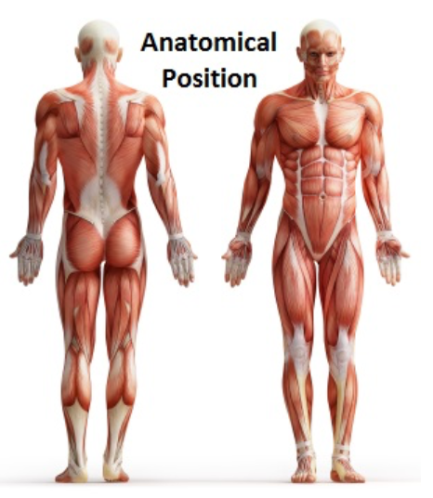
Anatomical position
Refers to the body position as if the person were standing upright with the:
Head, gaze (eyes), and toes directed anteriorly (forward)
Arms adjacent to the sides with palms facing anteriorly
Lower limbs close together with the feet parallel
Notes:
https://medicine107.wordpress.com/2014/12/22/anatomical-position/

Slide 21
Median plane (median sagittal plane)
The vertical plane passing longitudinally through the body, divides the body into right and left halves. The plane defines the midline of the head, neck, and trunk where it intersects the surface of the body.

Slide 22
Sagittal planes
Vertical planes passing through the body parallel to the median plane. Parasagittal is commonly used but is unnecessary because any plane parallel to and on ether side of the median plane is sagittal by definition.

Slide 23
Frontal (coronal) planes
Vertical planes passing through the body at right angles to the median plane, dividing the body into anterior (front) and posterior (back) parts.

Slide 24
Transverse planes
Horizontal planes passing through the body at right angles to the median and frontal planes, dividing the body into superior (upper) and inferior (lower) parts.

Slide 25
Superior
Refers to a structure that is nearer the vertex, the topmost point of the cranium (skull).

Slide 26
Cranial
Relates to the cranium and is a useful directional term, meaning toward the head or cranium.

Slide 27
Inferior
Refers to a structure that is situated nearer the sole of the foot.

Slide 28
Caudal (tail)
Toward the feet or tail region, represented in humans by the coccyx (tail bone), the small bone at the inferior (caudal) end of the vertebral column.

Slide 29
Posterior (dorsal)
The back surface of the body or nearer to the back.

Slide 30
Anterior (ventral)
The front surface of the body.

Slide 31
Rostral
Often used instead of anterior when describing parts of the brain; it means toward the rostrum (beak); however, in humans it denotes nearer to the anterior part of the head.

Slide 32
Medial
Used to indicate that a structure is nearer to the median plane of the body.

Slide 33
Lateral
Stipulates that a structure is farther away from the median plane.

Slide 34
Dorsum
Usually refers to the superior aspect of any part that protrudes anteriorly from the body, such as the dorsum of the tongue, nose, penis, or foot. Also used to describe the posterior surface of the hand, opposite the palm.

Slide 35
Sole
The inferior aspect or bottom of the foot, opposite the dorsum, much of which is in contact with the ground when standing barefoot.

Slide 36
Plantar surface
Sole of the foot.

Slide 37
Proximal
Nearer to the attachment of a limb.

Slide 38
Distal
Further from the attachment of a limb.

Slide 39
Ipsilateral
Something occurring on the same side of the body as another structure (e.g. right thumb and right great (big) toe)

Slide 40
Contralateral
Occurring on the opposite side of the body relative to another structure (e.g. right hand is “contralateral” to the left hand)

Slide 41
Memory check: My wrist is what in relation to my elbow?
A: Proximal
B: Ipsilateral
C: Contralateral
D: Distal
E: Inferior

Slide 42
Memory check: My wrist is what in relation to my elbow?
A: Proximal (the elbow is proximal to the wrist, or closer to the point of attachment, which is the shoulder in this case)
B: Ipsilateral (didn’t specify which side I was talking about, just wrist and elbow in general)
C: Contralateral (didn’t specify which side I was talking about, just wrist and elbow in general)
D: Distal (the wrist is further away from the point of attachment for the arm; the shoulder)
E: Inferior (although this is a tempting answer, you can move your arm around and make your wrist superior or inferior to your elbow, making distal the most correct answer)

Slide 43
Part 3: Terms of movement

Slide 44
Flexion
Bending or decreasing the angle between the bones or parts of the body.

Slide 45
Extension
Straightening or increasing the angle between the bones or parts of the body.

Slide 46
Dorsiflexion
Flexion at the ankle joint, occurs when walking uphill or lifting the front of the foot and toes off the ground.

Slide 47
Plantarflexion
Bends the foot and toes toward the ground, as when standing on your toes.
(Think of pressing down on a gas pedal)

Slide 48
Abduction
Moving away from the median plane.

Slide 49
Adduction
Moving toward the median plane.

Slide 50
Circumduction
Circular movement that involves sequential flexion, abduction, extension, and adduction in such a way that the distal end of the part moves in a circle.

Slide 51
Rotation
Turning or revolving a part of the body around its longitudinal axis, such as turning one’s head to face sideways.

Slide 52
Medial rotation (internal rotation)
Brings the anterior surface of a limb closer to the median plane.

Slide 53
Lateral rotation (external rotation)
Takes the anterior surface away from the median plane.

Slide 54
Pronation
Rotates the radius medially so that the palm of the hand faces posteriorly, and its dorsum faces anteriorly.

Slide 55
Supination
Rotates the radius laterally and uncrossing it from the ulna, returning the pronated forearm to the anatomical position.

Slide 56
Eversion
Moves the sole of the foot away from the median plane, turning the sole laterally.

Slide 57
Inversion
Moves the sole of the foot toward the median plane, facing the sole medially.

Slide 58
Opposition
Movement by which the pad of the 1st digit (thumb) is brought to another digit pad. This movement is used to pinch, button a shirt, and lift a teacup by the handle.

Slide 59
Protrusion
Movement anteriorly as in protruding the mandible (chin), lips, or tongue.

Slide 60
Protraction
Anterolateral movement of the scapula on the thoracic wall.

Slide 61
Retraction
Posteromedial movement of the scapula on the thoracic wall.

Slide 62
Elevation
Raises or moves a part superiorly.

Slide 63
Depression
Lowers or moves a part inferiorly.

Slide 64
Memory check: When you shrug your shoulders, which pair of motions do you use?
A: Flexion and extension
B: Internal and external rotation
C: Inversion and eversion
D: Supination and pronation
E: Elevation and depression

Slide 65
Memory check: When you shrug your shoulders, which pair of motions do you use?
A: Flexion and extension (mainly at the knee and elbow, but can occur in the shoulder and hips as well)
B: Internal and external rotation (rotator cuff muscles help out with these motions)
C: Inversion and eversion (done at the ankle, inversion injuries are very common)
D: Supination and pronation (done with the radius bone, flipping your hands over and back)
E: Elevation and depression

Slide 66
Part 4: Classification of bones, bone markings

Slide 67
Bone
Living tissue, high specialized, hard form of connective tissue that makes up most of the skeleton.

Slide 68
Long bones
Tubular (e.g. humerus in the arm)

Slide 69
Short bones
Cuboidal and are found only in the tarsus (ankle) and carpus (wrist)

Slide 70
Flat bones
Usually serve protective functions (e.g. parts of the cranium protect the brain)

Slide 71
Irregular bones
Various shapes other than long, short, or flat (bones of the face)

Slide 72
Sesamoid bones
Develop in certain tendons and are found where tendons cross the ends of long bones in the limbs; they protect the tendons form excessive wear and often change the angle of the tendons as they pass to their attachments.

Slide 73
Capitulum
Small, round, articular head (e.g. capitulum of the humerus)

Slide 74
Condyle
Rounded, knuckle-like articular area, often occurring in pairs (e.g. the lateral and medial femoral condyles)

Slide 75
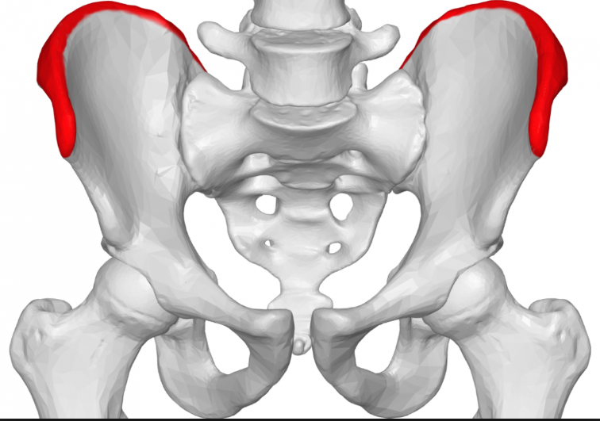
Crest
Ridge of bone (e.g. iliac crest 🡪 you must know where this is as a DO student)
Notes:
https://www.google.com/search?q=iliac+crest&rlz=1C1NDCM_enUS752US752&source=lnms&tbm=isch&sa=X&ved=0ahUKEwjWjcCTm7TiAhVIJTQIHUypDygQ_AUIDigB&biw=1280&bih=610&dpr=1.5#imgrc=gd9IFklEb9vuVM:

Slide 76
Epicondyle
Eminence superior or adjacent to a condyle (e.g. lateral epicondyle of the humerus)

Slide 77
Facet
Smooth flat area, usually covered with cartilage, where a bone articulates with another bone (e.g. superior costal facet on the body of a vertebra for articulation with a rib)

Slide 78
Foramen
Passage through a bone (e.g. obturator foramen)

Slide 79
Fossa
Hollow or depressed area (e.g. infraspinous fossa of the scapula)

Slide 80
Groove
Elongated depression or furrow (e.g. radial groove of the humerus)

Slide 81
Head
Large, round articular end (e.g. head of the humerus)

Slide 82
Line
Linear elevation (e.g. soleal line of the tibia)

Slide 83
Malleolus
Rounded process (e.g. lateral malleolus of the fibula)

Slide 84
Notch
Indentation at the edge of a bone (e.g. greater sciatic notch)

Slide 85
Protuberance
Projection of bone (e.g. external occipital protuberance)

Slide 86
Spine
Thorn-like process (e.g. the spine of the scapula)

Slide 87
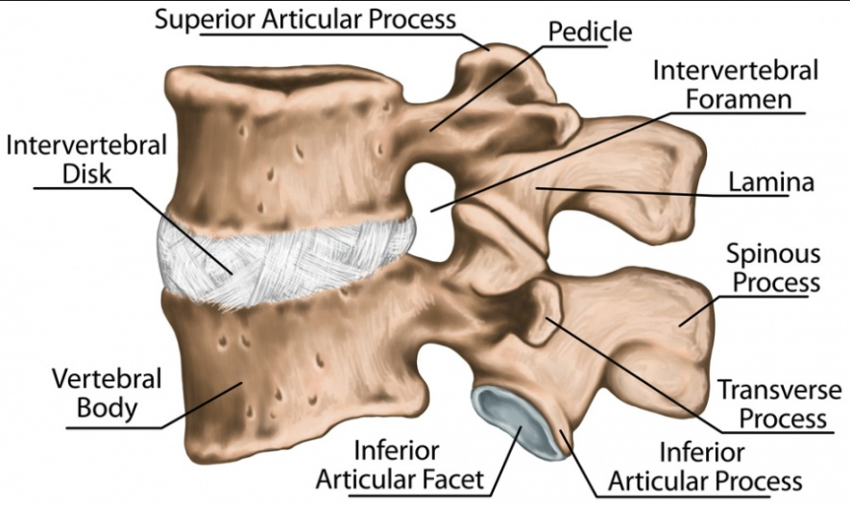
Spinous process
Projecting spine-like part (e.g. spinous process of a vertebra)
Notes:
https://www.google.com/search?q=spinous+process&rlz=1C1NDCM_enUS752US752&source=lnms&tbm=isch&sa=X&ved=0ahUKEwjS6_3sm7TiAhWkHjQIHWFNCesQ_AUIDigB&biw=1280&bih=610#imgrc=kRzKnazrluZgjM:

Slide 88
Trochanter
Large blunt elevation (e.g. greater trochanter of the femur)

Slide 89
Trochlea
Spool-like articular process or process that acts as a pulley (e.g. trochlea of the humerus)

Slide 90
Tubercle
Small raised eminence (e.g. greater tubercle of the humerus)

Slide 91
Tuberosity
Large rounded elevation (e.g. ischial tuberosity)

Slide 92
Part 5: Types of muscle/muscles

Slide 93
Skeletal striated muscle
Voluntary somatic muscle that makes up the gross skeletal muscles that compose the muscular system, moving or stabilizing bones and other structures (e.g. the eyeballs)

Slide 94
Cardiac striated muscle
Involuntary visceral muscle that forms most of the walls of the heart and adjacent parts of the great vessels, such as the aorta, and pumps blood.

Slide 95
Smooth muscle (unstriated muscle)
Involuntary visceral muscle that forms part of the walls of most vessels and hollow organs (viscera), moving substances through them by coordinated sequential contractions (pulsations or peristaltic contractions).

Slide 96
Flat muscles
Have parallel fibers often with an aponeurosis (e.g. external oblique, sartorius)

Slide 97
Pennate muscles
Feather-like in the arrangement of their fascicles, and may be unipennate (extensor digitorum longus), bipennate (rectus femoris), or multipennate (deltoid)

Slide 98
Fusiform muscles
Spindle shaped with a round, thick belly (or bellies) and tapered ends (e.g. biceps brachii)

Slide 99
Convergent muscles
Arise from a broad area and converge to form a single tendon (e.g. pectoralis major)

Slide 100
Quadrate muscles
Have four equal sides

Slide 101
Circular or sphincteral muscles
Surround a body opening or orifice, constricting it when contracted (e.g. orbicularis oculi closes the eyelids)

Slide 102
Multiheaded or multibellied muscles
Have more than one head of attachment or more than one contractile belly, respectively (e.g. biceps brachii, triceps brachii, digastric, gastrocnemius)

Slide 103
Hope this helps!
These definitions and terms are taken straight from your Moore Anatomy textbook, it’s just always nice to have it in powerpoint form in my opinion.
If you have any questions about the terminology or anything in general here is my email:
taylor.yancey@rvu.edu

